Slide 1


Re-thinking Employee Engagement
Kellen Winters
Teams Platform Lead
Mauri Rappuzi
MW Product Marketing Manager
#mwsummit

Slide 2

Raise your hand ✋ If you or someone you know has recently talked about or is in the process of looking for a new job.
#mwsummit

Slide 3




The Driving Force for any Business is its People
Employee engagement
86% of top-performing companies say that digital training programs boosted employee engagement and performance.¹
Employee satisfaction
94% of employees say they would stay at a company longer if it invested in their learning and development.²
Employee retention
Highly engaged employees are 12x less likely to leave their company than those who are not engaged.³
Profitability
Organizations with highly engaged employees have 21% greater profitability.⁴
¹PwC’s Global Digital IQ survey. ²LinkedIn Learning 2020 Workplace Learning Report. ³Glint. ⁴Gallup.

Slide 4
The Dilemma
Employee Experience is directly correlated with Customer experience, which creates a need to invest in better employee engagement
BUT…
Any strategy must improve margins to make room for cost
+
No more room to squeeze margins to add in new tools
+
No effective way to drive change down to front-line associates
#mwsummit

Slide 5
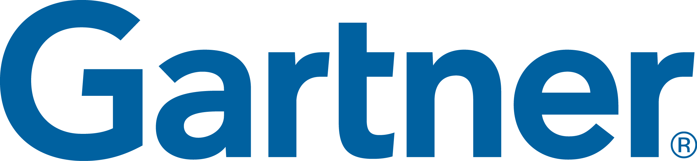
Top 3 Contributors to Employee Engagement
Highly Engaged Employees experience this:
Disengaged Employees experience this:
HIGH
ENGAGEMENT
99%
98%
99%
Know what’s expected of them at work
89%
70%
53%
LOW
ENGAGEMENT
Have the tools needed to do their job
Feel they are able to do their best every day
Gartner, Drive Employee Experience for Frontline Workers Using HR Technology, By Sam Grinter, 15 September 2021

Slide 6







Organizations Must Quickly Adapt
Agility
Employee
Engagement
Operational
Efficiency
Revenue
Augmentation

Slide 7
What area of employee engagement are you focused on most right now?
?
#mwsummit

Slide 8


What is an employee experience platform (EXP)​ A digital platform that helps organizations create a thriving culture with engaged employees and inspiring leaders
Purpose & Alignment
Mission, Goals & Outcomes
Achievements & Recognition
Growth & Development
Learning & Coaching
Onboarding, Lifecycle Moments
Talent Mobility
Culture & Communications
News, Events, Company Resources, Communities
Wellbeing & Engagement
Physical, Mental, Financial Nudges, Feedback & Sentiment
Knowledge & Expertise
People & Experts
Documents & Content
Employee

Slide 9


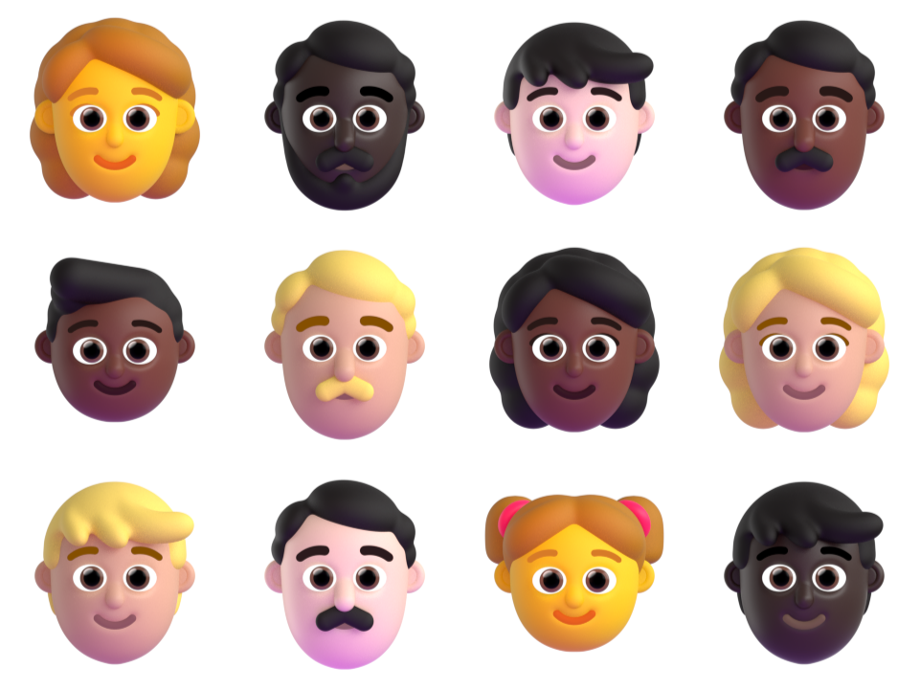
MW | Collaborative Apps | HR | 01 & 02
Common business challenges
Ask yourself...
01
02
Company Culture The multi-generational workforce demands more flexible work styles. Organizations needs to be agile by adapting communication and productivity practices to changing business and labor market conditions, as well as the needs and preferences of a diverse workforce. | Data-driven decision making Organizations need to compete to attract and retain the best employees. They increasingly see data and analytics as important to recruiting and retaining top talent. Their workforce also has the desire to leverage data to be and perform at their best.
Organization and Communication Globalization and changing employee expectations are demanding more innovative culture creation practices. Organizations wants to connect existing systems into one integrated platform. | Employee Training and skill growth A collaborative workforce is critical to corporate effectiveness. Organizations needs to implement social solutions that ensure the workforce, leadership, and feedback loops are working and learning together.
How does your company accommodate flexible work styles?
How does your company attract the talent it needs?
What tools and policies does your organization get asked for most often?
How are you analyzing data around employees effectively today? How do you give them access to data?
Which channels do your employees use to get info about your company/their learnings, and how are you engaging them there?

Slide 10
MW | Collaborative Apps | HR | 03 & 04
Paint the solution vision using scenarios
Human Resources
03
Company culture and communication | Employee Training and skill growth | Data-driven decision making
Employee engagement is critical Organizations with highly engaged employees have 21% greater profitability¹ In highly engaged companies, employees are 12x less likely to leave² Only 15% of the global workforce feels engaged at work¹ | 94% of employees would stay at a company longer if it invested in learning & development³ 49% of people report that they don’t have enough time to learn at work³ 74% of CEOs say talent and skills of their workforce is their number one concern⁴ | Turn complex data into powerful, visual graphics to make informed and data-driven HR decisions.
04
Use key resources
Outcomes | Scenario BDM and ITDM are customer leave behinds, MS Field is internal-only guidance
Enable hybrid work environments | Company Culture and Communication (BDM/ITDM, MS Field) Employee Training and skill growth (BDM/ITDM, MS Field)
Automate and optimize processes | Data-driven decision making (BDM, ITDM, MS Field, Snackable video series) Approvals/ Digital Signing (BDM, ITDM, MS Field, demo, 2022 video) Project Management (BDM, ITDM, MS Field)
¹ Gallup’s State of the Global Workplace 2021 ² Glint ³ LinkedIn Learning 2020 Workplace Learning Report ⁴ PWC - Global CEO - Talent trends 2020

Slide 11


Driving Employee Experience at Toyota North America
#mwsummit

